Slide 1
R from python
Python has an R api called Rpy2. You can install it with conda install rpy2 or pip install rpy2. We'll just cover some really basic examples.

Slide 2
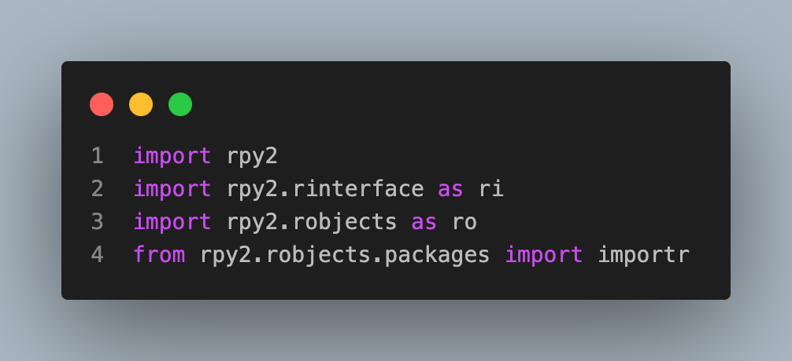
Imports

Slide 3
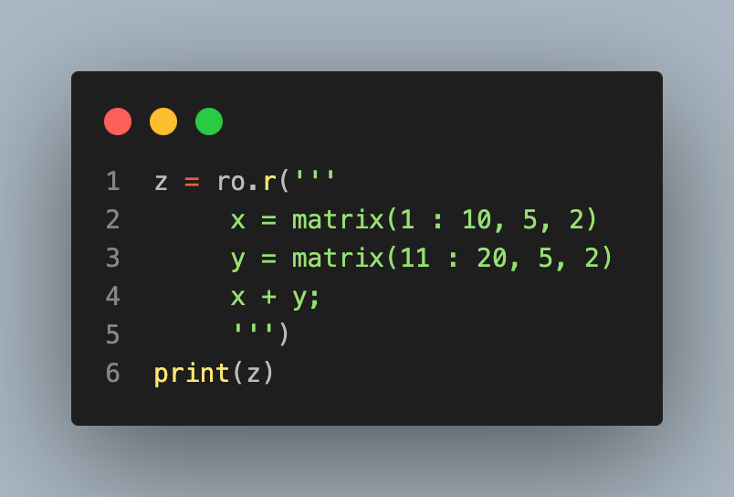
R objects
The robjects sub-library contains the simplest variation of the interface
Here's an example of executing R code in a python session.
[,1] [,2]
[1,] 12 22
[2,] 14 24
[3,] 16 26
[4,] 18 28
[5,] 20 30

Slide 4
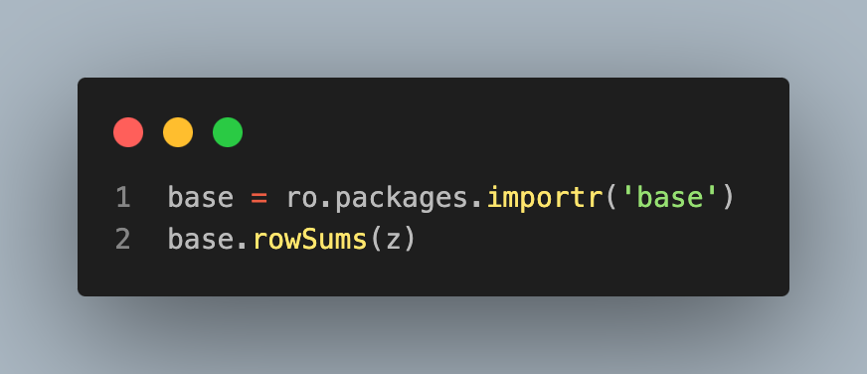
You can then operate on this matrix in python.
Here's an example where we import the base R library and use it on the objects we previously defined.
FloatVector with 5 elements.
34.000000 | 38.000000 | 42.000000 | 46.000000 | 50.000000

Slide 5
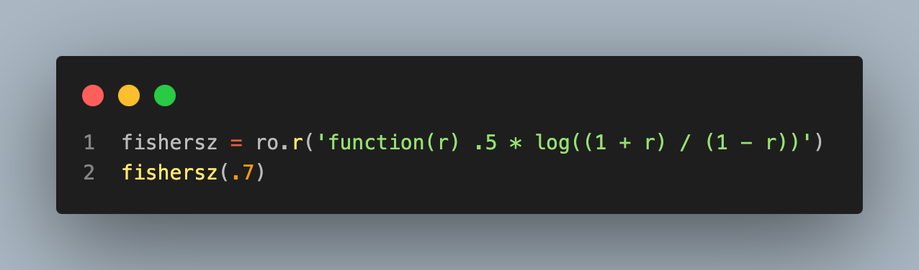
Functions
Here's an example of defining a function in R and using it in python.
0.867301

